Slide 1

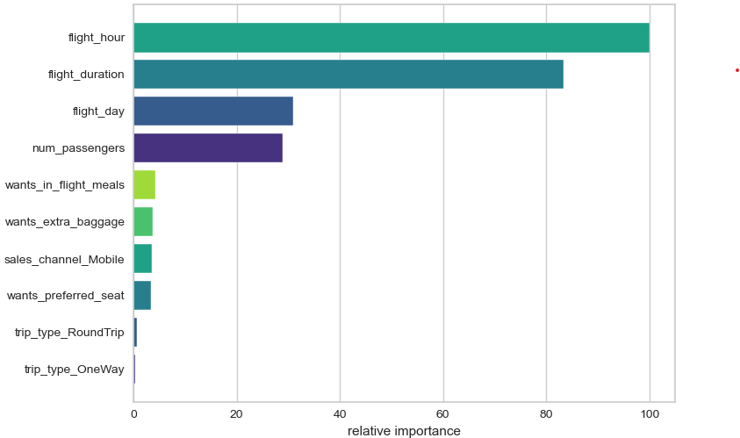
Contribution of variables in the Random Forest Classifier Model
Predict whether a customer will book
The image shows a graph of the relative importance of features in a random forest classifier.
The graph shows that the most important features in the model are flight hour, flight duration, and flight day. This means that these features are the most likely to affect whether a passenger will book a holiday with us.
On the other hand the company should delve deeply into the variables of sales channels and options of meals, seat or extra baggage and formulate a plan to address customer pain points.
By Diego Sanmiguel
https://www.linkedin.com/in/diegosanmiguelvargas/
https://github.com/dasanmiguelv/supervised-machine-learning/tree/main/behaviour-buying

